Slide 1
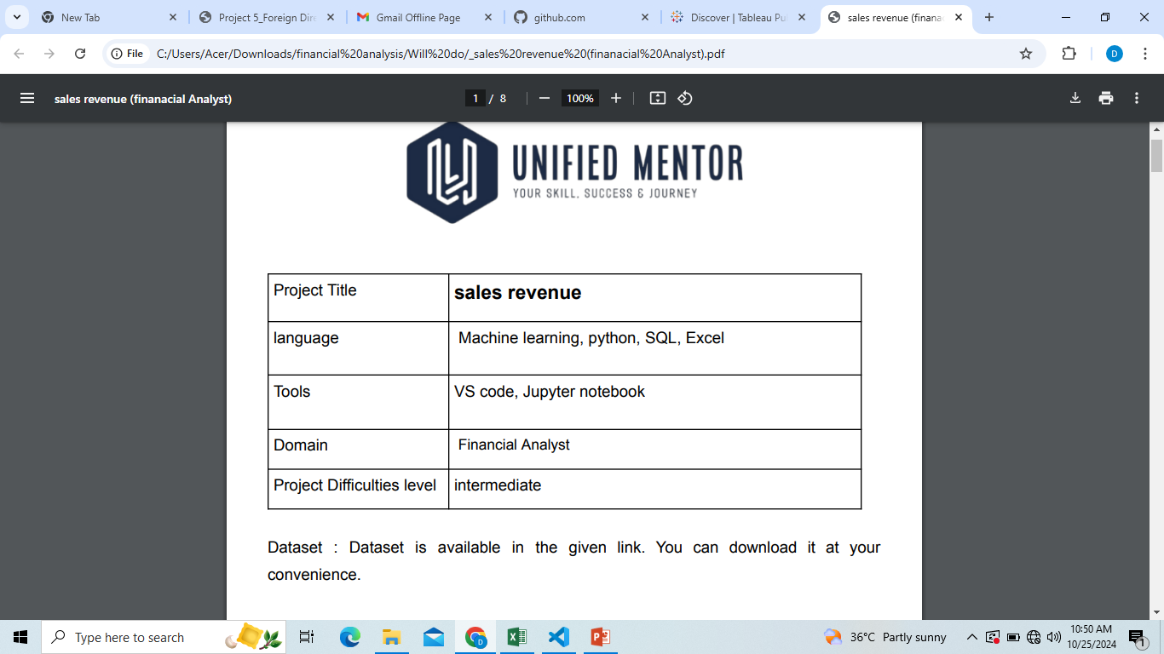
PROJECT 1 -SALES REVENUE {FINANCIAL ANALYST} BY HARSHITA SINGH

Slide 2
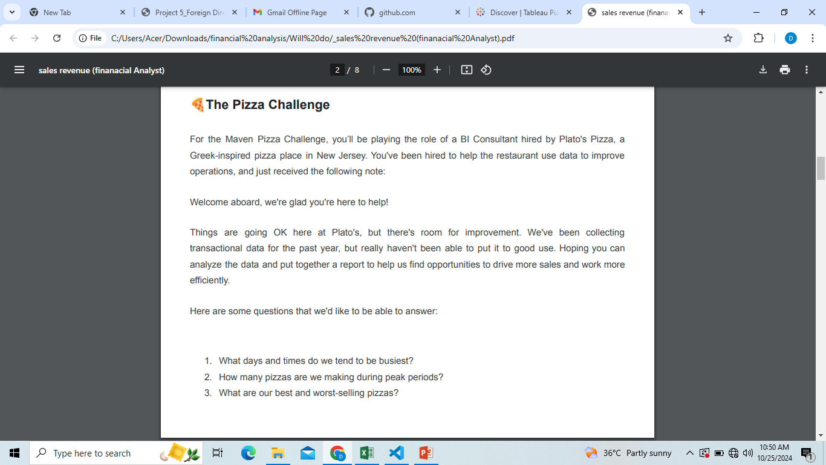

Slide 3
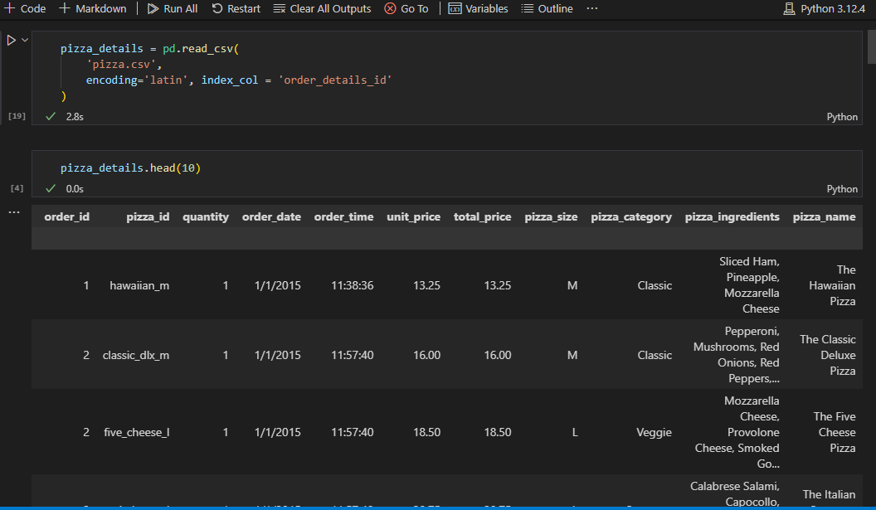
QUESTION 1) What days and times do we tend to be busiest?

Slide 4
CODE OVERVIEW FOR SOLUTIONS
EXTRACT DATA FROM CSV INPUT FILE USING READ CSV FUNCTION OF PANDAS
CONVERT THE STRING FORMAT DATA TO DATETIME FORMAT
PERFORM AGGREGATION USING GROUP BY FUNCTION
PLOT THE RESULT IN FORM OF BAR GRAPGH USING CATPLOT FUNC OF SEABORN LIBRARY

Slide 5
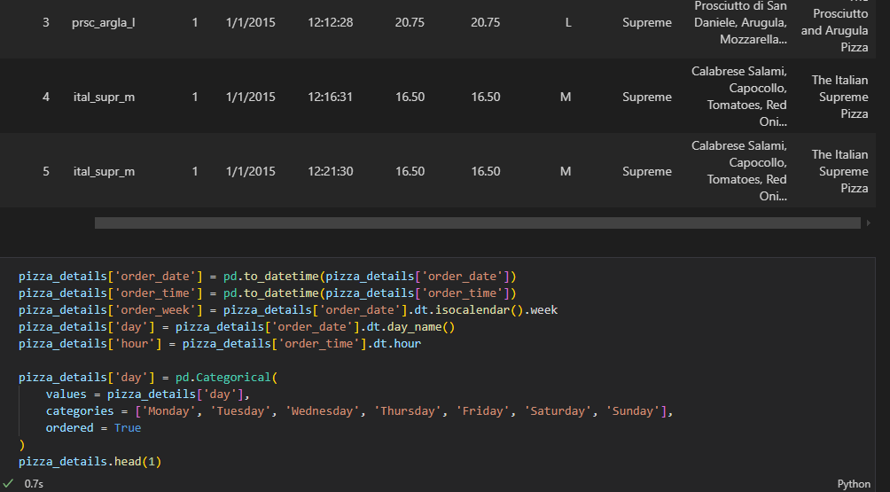

Slide 6
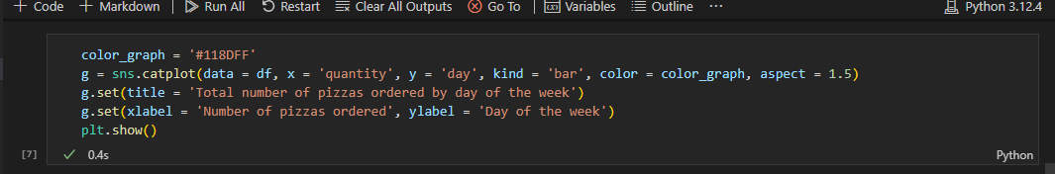
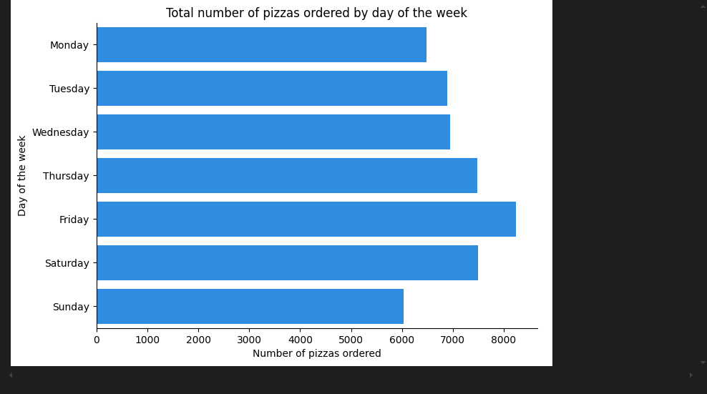

Slide 7
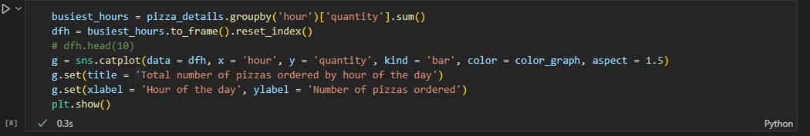
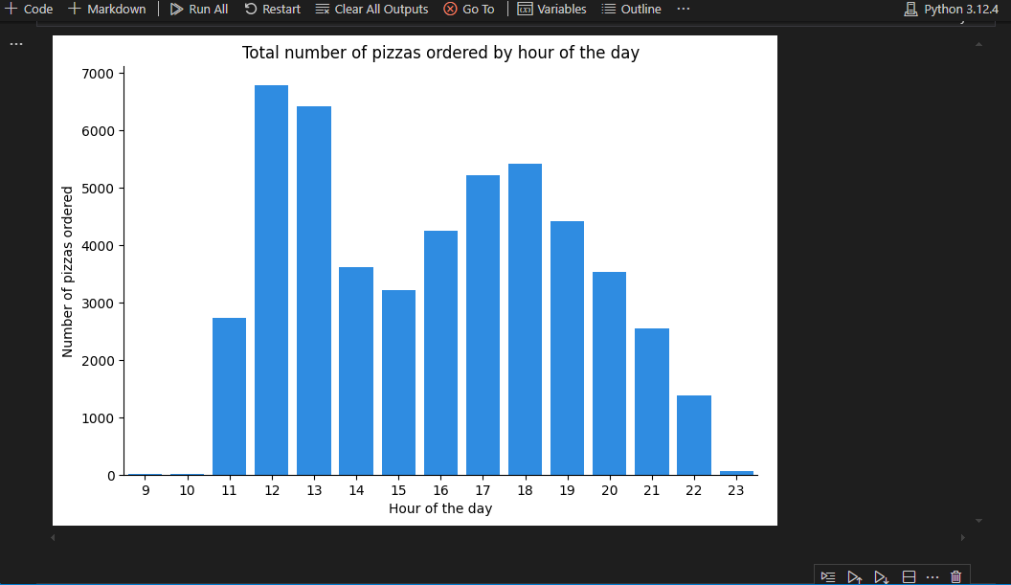

Slide 8
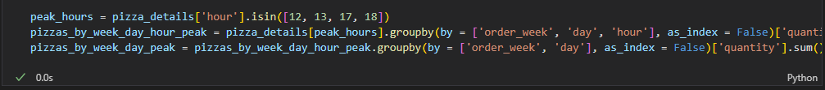
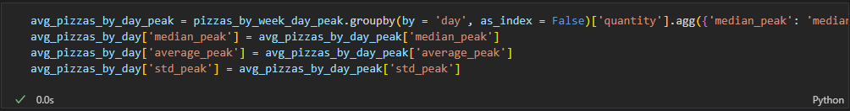
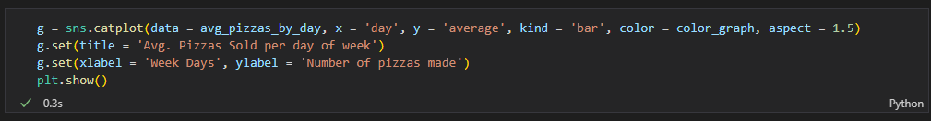
QUESTION 2) How many pizzas are we making during peak periods?

Slide 9
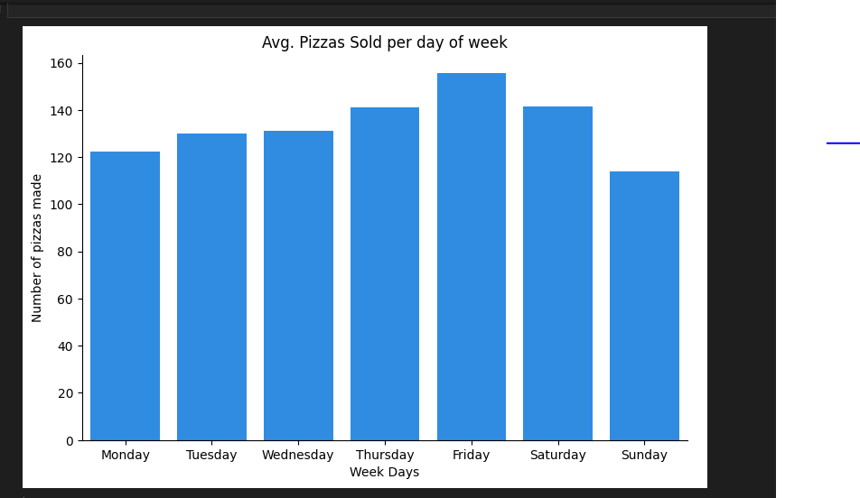

Slide 10
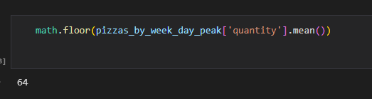
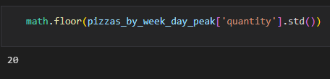
PEAK VAULES IN WEEK ARE -
MEAN VALUE
STANDARD DEVIATION VALUE

Slide 11
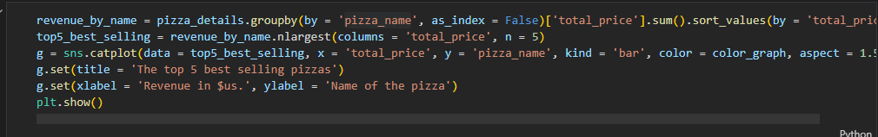
QUESTION 3- What are our best and worst-selling pizzas?

Slide 12
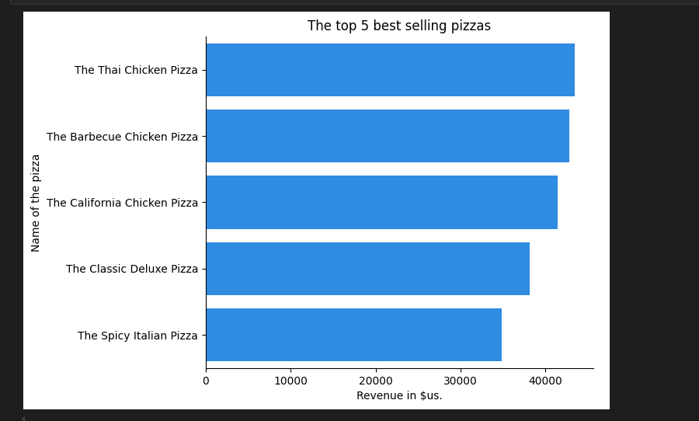
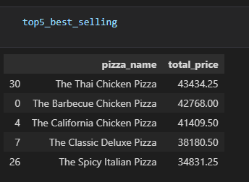

Slide 13
